Slide 1
CSCI 544
Deep Learning for NLP:
Lecture 2
http://sami.haija.org/cs544/DL2

Slide 2
NLP-DL1 Lecture Recap
Machine Learning Programs consist of:
Training Data (comes from the task): (x₁, y₁), … (x_{n}, y_{n}).
Model (f) is parametrized by Θ and transforms input to output f_{Θ} : x → y.
Θ is trained on on the training data (improves prediction accuracy on training examples)
To minimize a loss measure (L). Usually, cross entropy, as justified by Maximum Likelihood Estimation, Logs-odd-ratio, and Information Theory.
By a training algorithm: Gradient Descent, where gradients are calculated using Backpropagation.
TensorFlow:
Allows us to express the transformation (f_{Θ} : x → y) e.g. as a Neural Network.
Derive analytical expressions of symbolic gradients of loss (L) w.r.t. Θ.
Perform an update step on Θ using the analytical symbolic gradient, which can be evaluated to real gradient given a batch of examples.
We coded each document as a flat vector, ignoring relative position of words.
This is fine for some applications (e.g. classification) but we ought to have better performance when adding positional information.
Impossible for Part of Speech tagging or Machine Translation.

Slide 3
Deep Learning / TensorFlow Assignments
Next coding assignment will be on Deep Learning & TensorFlow
Work-in-progress (flash it).
It will give you invaluable experience with coding Deep Learning models (useful for NLP and other fields).
People familiar with TensorFlow/python/numpy could finish in a couple of hours. People new to TensorFlow or Python might need more time.

Slide 4
Deep Learning on Exam 2?
We have not made exam 2 yet.
This lecture series is a “special addition” to CS544 -- no past exams have this.
If Deep Learning and/or TensorFlow were on it, we will issue “practice questions” to resemble what you would be asked on the exam.

Slide 5
Today’s Topic
Modeling Sequences using Deep Networks.
From the ML stack: (Data, Model, Training Algorithm): we will discuss the “Model” part. The model can be applied to different applications
Applications include:
Part-of-speech tagging: Given a sentence, annotate every word as a verb, noun, pronoun.
Machine Translation: Given a sentence in one (source) language, translate it to another (target) language.
Why Sequences?
Word-order contributes to meaning: Consider “This is the best movie by far” VS “This is far from the best movie”.
Need to overcome challenge: Documents lengths can vary (aka variable-length input).

Slide 6
Model Overview
(I, like, this, movie)
Sentiment Classifier
(or Predict Next word)
Translation
POS Tagging
positive
Classification: Fixed-length output
mujhe yah philm pasand hai
(PN, V, A, N)
Same-length output (aka segmentation in vision)
Variable-length output
Each task has different output type: part of the model (encoder) does not care about output type. Only decoder cares about output type!

Slide 7
Model Overview
Legend
(I, like, this, movie)
Zero vector
Word Embeddings
RNN Cell
State Vector

Slide 8
Model Overview
(I, like, this, movie)
Encoder
Zero vector

Slide 9
Model Overview
(I, like, this, movie)
Encoder
Zero vector
Classification Decoder
positive

Slide 10
Model Overview
(I, like, this, movie)
Encoder
Zero vector
POS Tagger
POS Tagger
POS Tagger
POS Tagger
PN
V
A
N

Slide 11
Model Overview
(I, like, this, movie)
Encoder
Zero vector
Translation (variable-length) Decoder
Sentence in target language

Slide 12
Agenda
The Back Propagation Algorithm
Back Propagation Through Time (BPTT)
Models
Attention Overview
Recurrent Networks
Attention + Recurrent
Attention Only
TensorFlow Coding

Slide 13
Agenda
The Back Propagation Algorithm
Back Propagation Through Time (BPTT)
Models
Attention Overview
Recurrent Networks
Attention + Recurrent
Attention Only
TensorFlow Coding

Slide 14
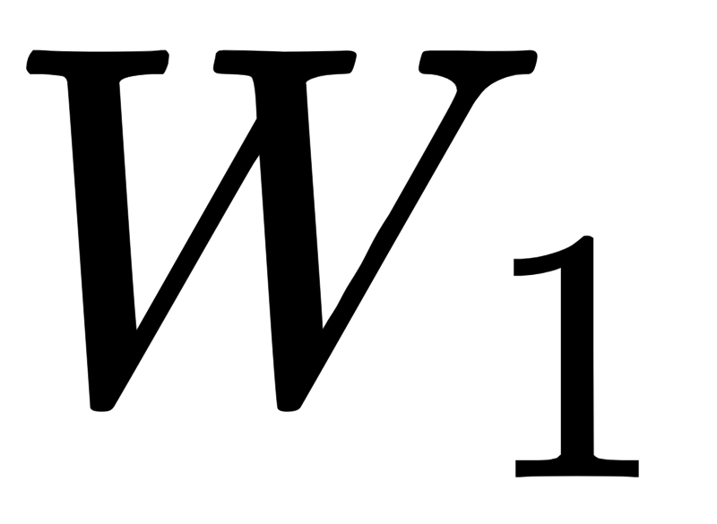

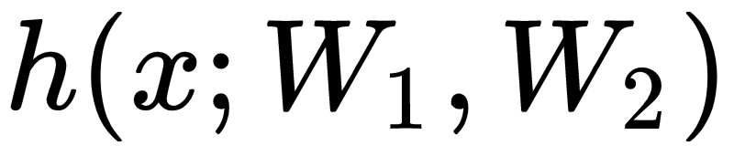
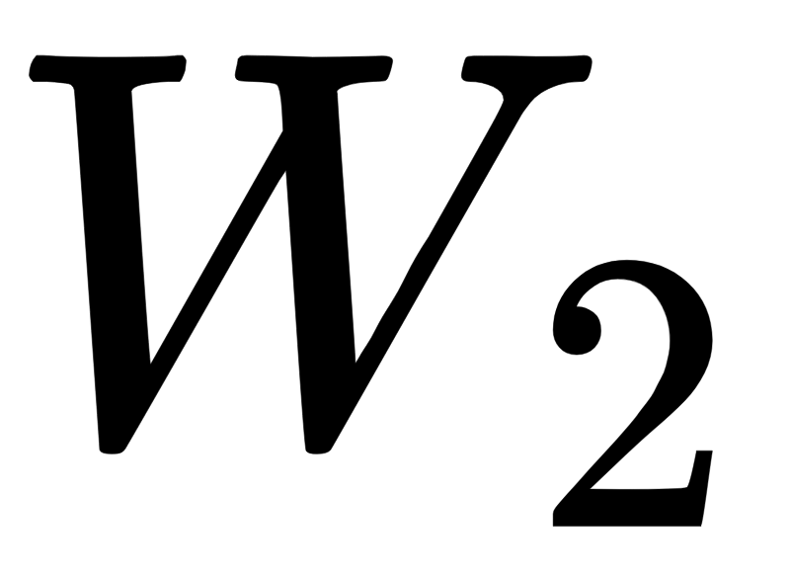
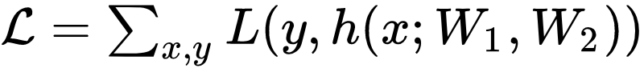
Backpropagation Algorithm (backprop)
Neural Network can be seen as a directed acyclic “graph”
multiply
concat
σ
Loss can be measured between model output and expected output. The gradient of loss can be backpropagated (i.e. efficient computation of chain rule)
conv
‹#›

Slide 15
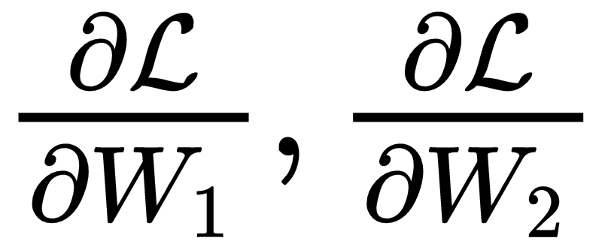
Backpropagation Algorithm (backprop)
multiply
concat
σ
conv
Want: to optimize W_{1,} W₂ via gradient descent
‹#›

Slide 16
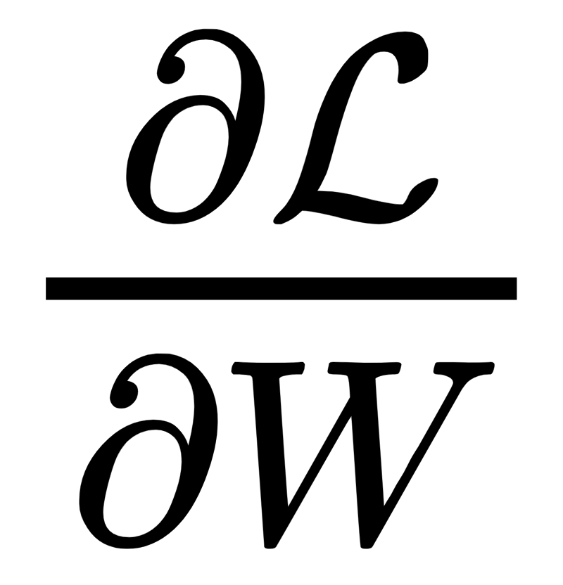

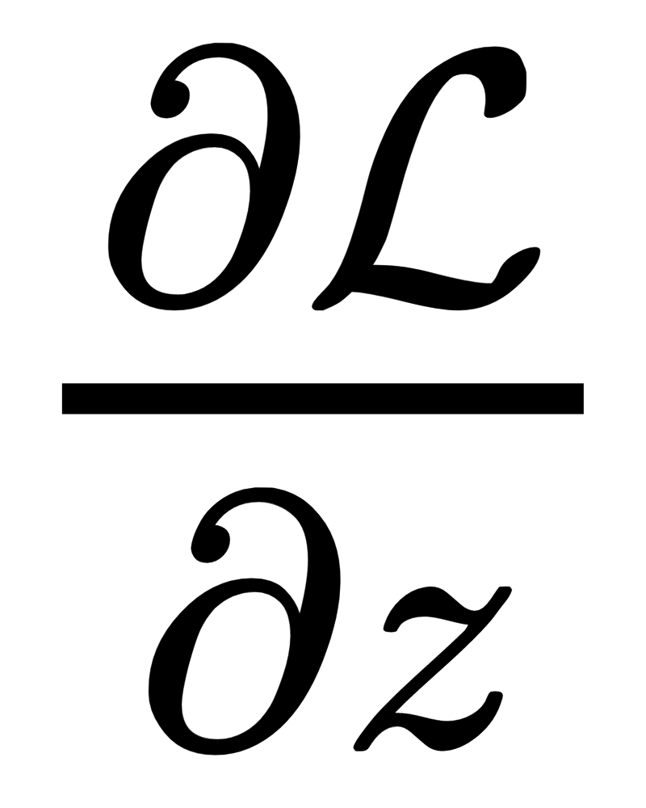
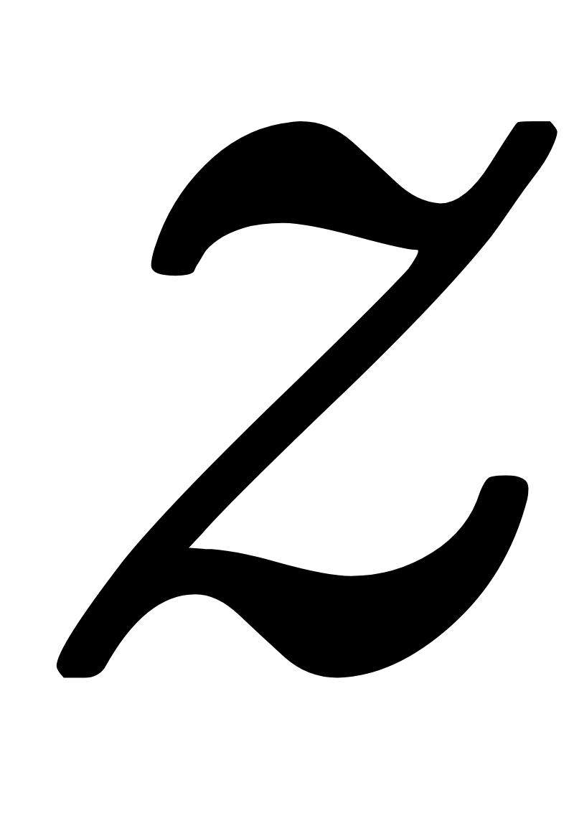
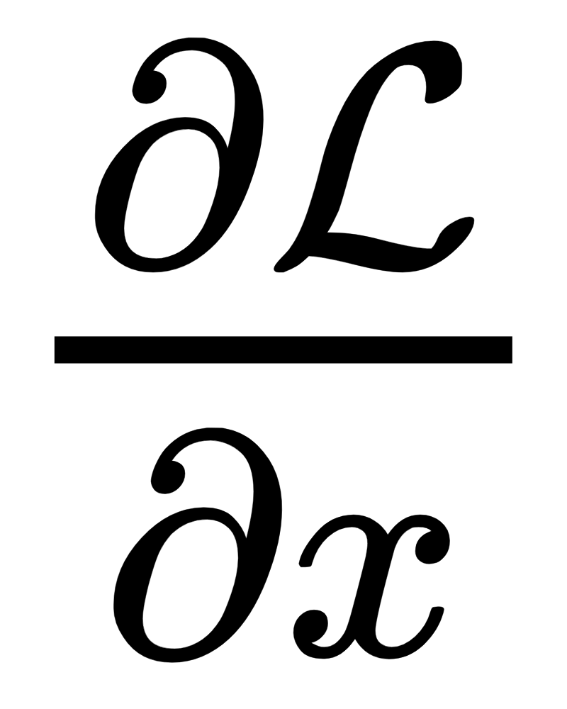
Backpropagation Algorithm (backprop)
Every block must provide forward pass and backward pass:
Forward
Backward
multiply
multiply
multiply
Running from top-to-bottom (right-to-left in diagram) using topological sort provides an elegant way of deducing the neural connections W
‹#›

Slide 17
Backprop Derivation Rules
In practice, no need to derive by-hand. Tensorflow does it for us!
However, being aware can influence your decisions.
Do by-hand derivation of:
Element-wise Activation.
Matrix Multiply.
Concatenation.
Element-wise Addition.
L1/L2 Regularization of Parameters.

Slide 18
Agenda
The Back Propagation Algorithm
Back Propagation Through Time (BPTT)
Models
Attention Overview
Recurrent Networks
Attention + Recurrent
Attention Only
TensorFlow Coding

Slide 19


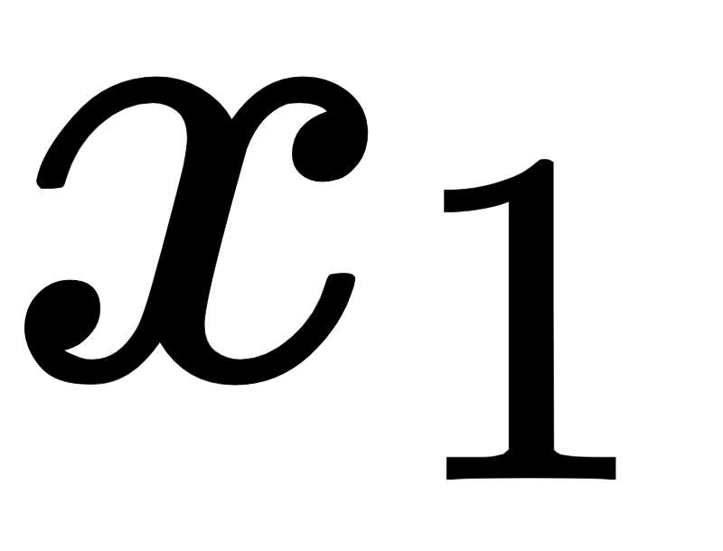
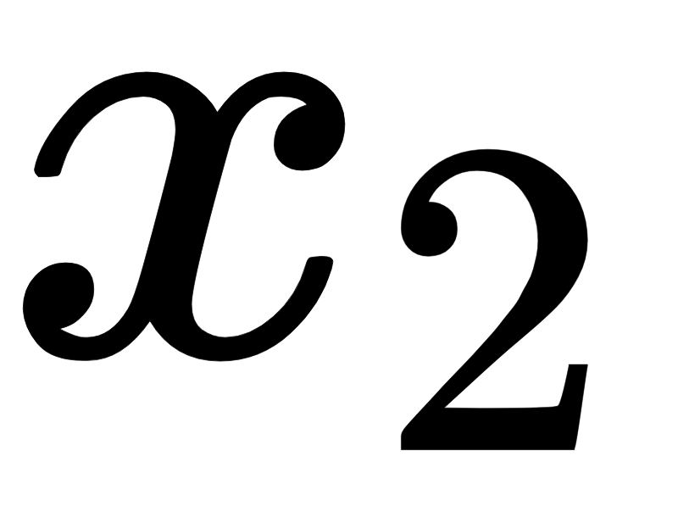
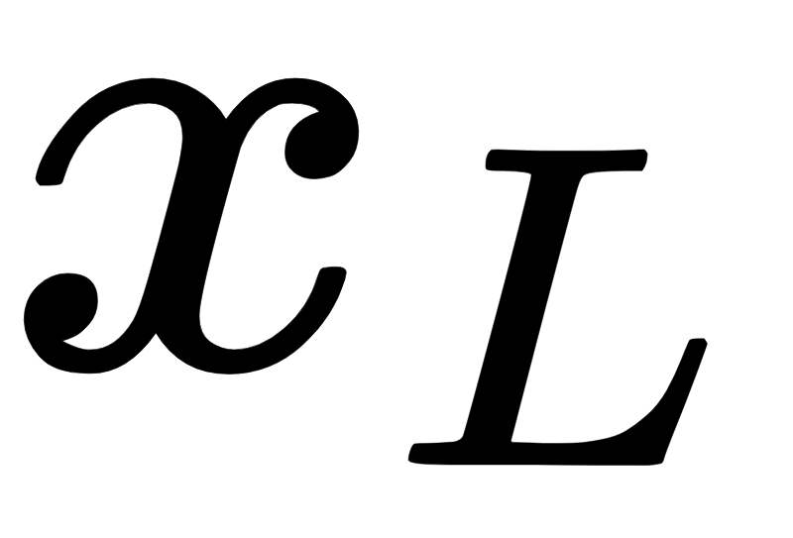
Backpropagation Through Time
...
multiply
multiply
multiply
concat
σ
concat
σ
concat
σ
How to calculate ?
Treat W as if it is different variables
‹#›

Slide 20
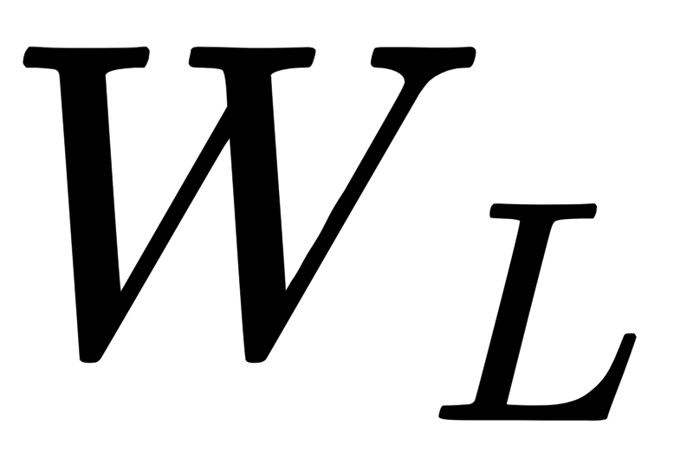
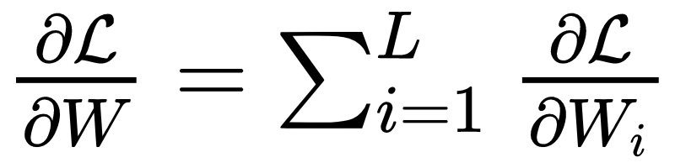
Backpropagation Through Time
...
multiply
multiply
multiply
concat
σ
concat
σ
concat
σ
How to calculate ?
Treat W as if it is different variables
Feed them same value!
Calculate:
‹#›

Slide 21
Practical Considerations (Vanishing/Exploding Gradients)
Which term contributes more to the sum?
Which terms dominate the gradient?

Slide 22
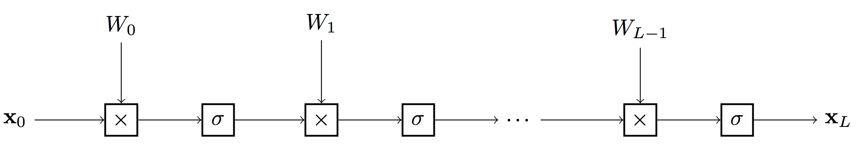
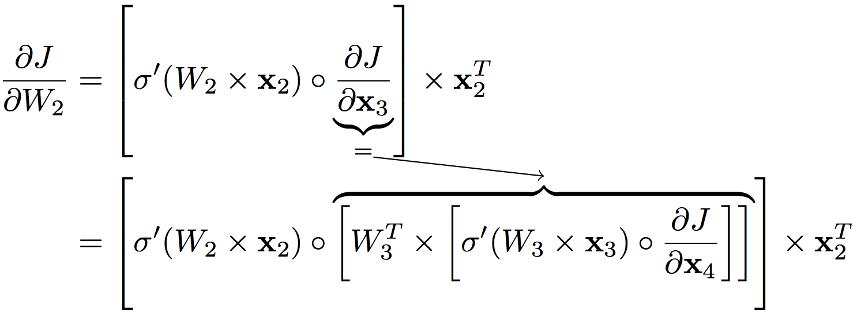
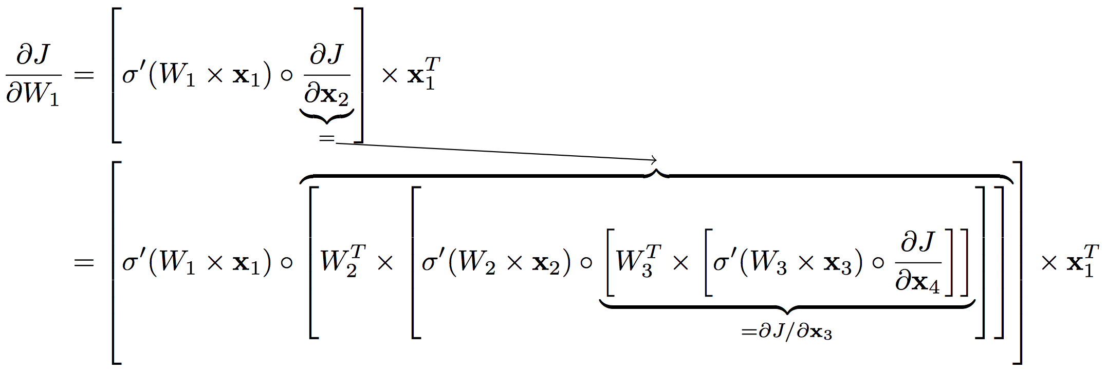
Practical Considerations
Does Contribution from early larger than later words? It depends on:
The norm of x (i.e. activation)
The derivative of element-wise activation
Values of W (i.e. initialization)
Researchers developed:
Good initialization.
Good activation (e.g. tanh).
LayerNorm, BatchNorm, WeightNorm.
Residual (skip) Connections

Slide 23
Agenda
The Back Propagation Algorithm
Back Propagation Through Time (BPTT)
Models
Attention Overview
Recurrent Networks
Attention + Recurrent
Attention Only
TensorFlow Coding

Slide 24
Attention for Classification
(I, like, this, movie)
Rather Than:
Encoder
Zero vector
Classification Decoder
positive
Note: Attention is more applicable in Translation and Segmentation. Demo this as intro

Slide 25
Attention for Classification
(I, like, this, movie)
Can We?
Encoder
Zero vector
Yes We can!
Classification Decoder
positive
For Vision application, see: Ramanathan, Huang, Abu-El-Haija, Gorban, Murphy, CVPR 2016.
How do we go from unknown number of timesteps into a single decision? Demonstrate

Slide 26
Agenda
The Back Propagation Algorithm
Back Propagation Through Time (BPTT)
Models
Attention Overview
Recurrent Networks
Attention + Recurrent
Attention Only
TensorFlow Coding

Slide 27
Show RNNs (with and without attention) through Slides Below
https://nlp.stanford.edu/~johnhew/public/14-seq2seq.pdf

Slide 28
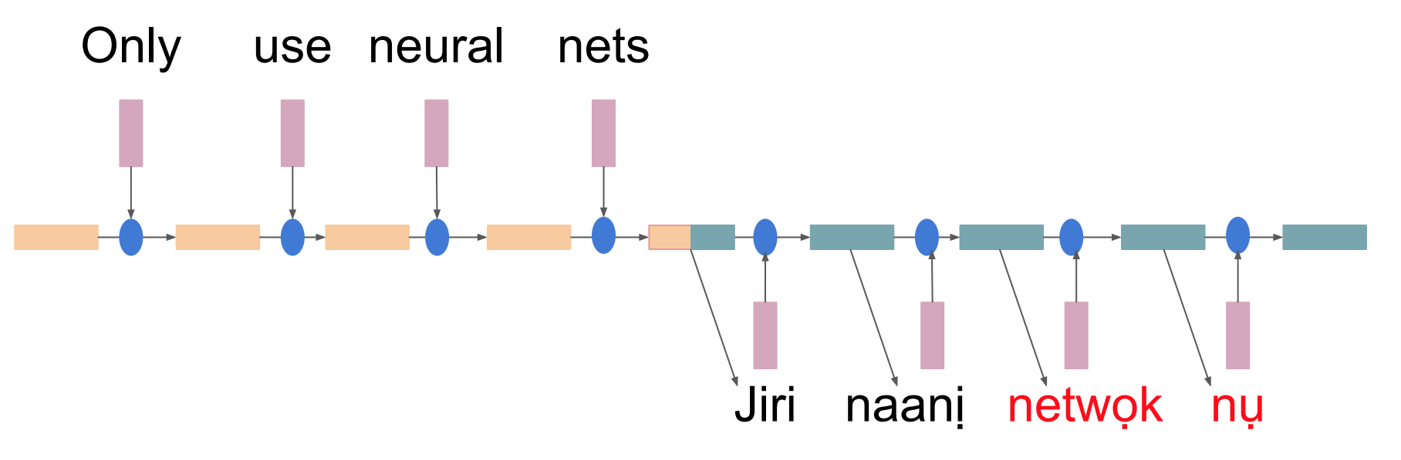
Clarifications
Softmax vectors. Sums to 1. Loss is measured (and backpropped from) here
Embedding of word at the argmax of softmax

Slide 29
Some Notes
There are many different RNN cells. Most popular are GRUs and LSTMs.
Connections do not have to be strictly “linked-list”. Skip connections are often helpful (e.g. element-wise Addition of previous layer).
RNNs can be bi-directional rather than unidirectional.

Slide 30
Agenda
The Back Propagation Algorithm
Back Propagation Through Time (BPTT)
Models
Attention Overview
Recurrent Networks
Attention + Recurrent
Attention Only
TensorFlow Coding

Slide 31
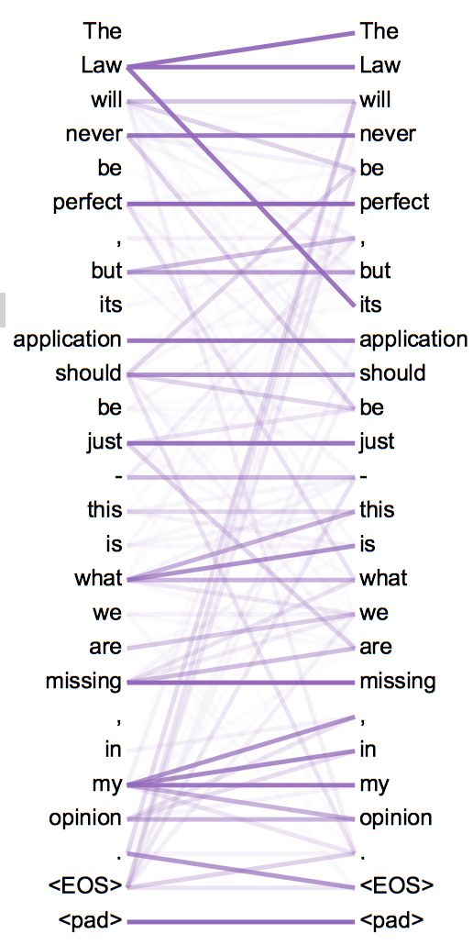
Attention is All You Need
Paper Link [optional reading]: https://arxiv.org/pdf/1706.03762.pdf
Rather than propagating information forward in time
process all words simultaneously in parallel, then let them all attend to each other (self attention).
Encode position through harmonic series to enable words have relative distance information
Attention Visualization →

Slide 32
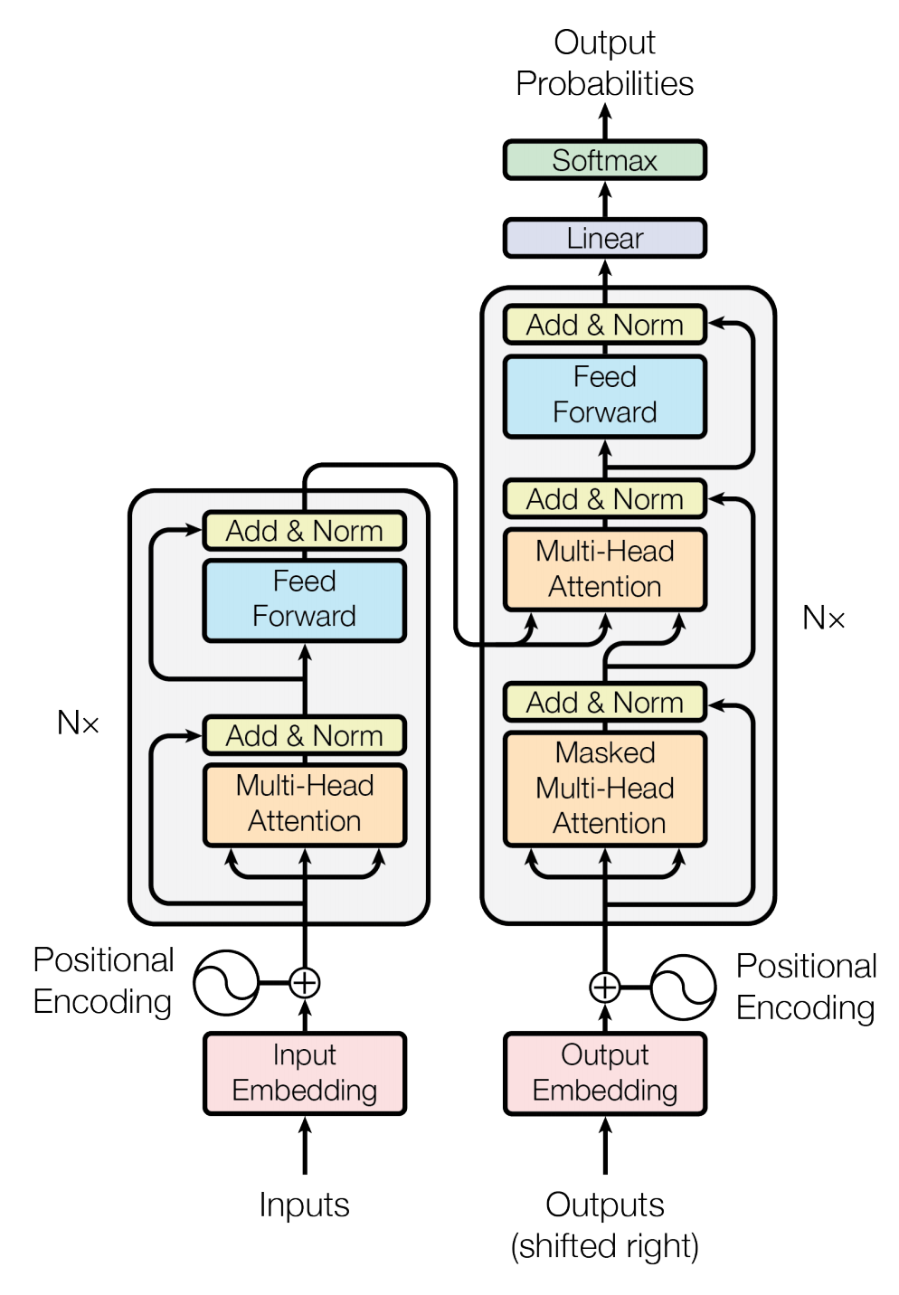
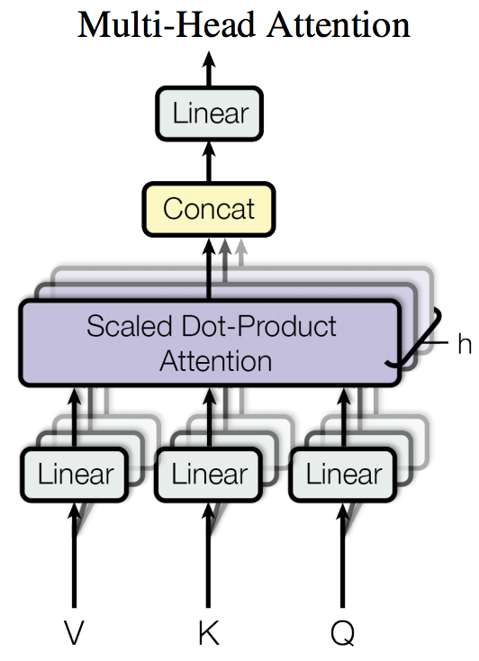
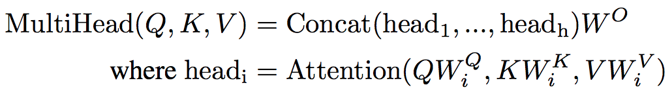
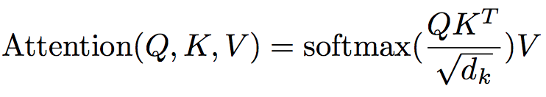
Attention is All You Need: Model Architecture

Slide 33

Model illustration (http://jalammar.github.io/illustrated-transformer/)

Slide 34
Agenda
The Back Propagation Algorithm
Back Propagation Through Time (BPTT)
Models
Attention Overview
Recurrent Networks
Attention + Recurrent
Attention Only
TensorFlow Coding

Slide 35
TensorFlow Coding
Flash Tutorial: https://github.com/tensorflow/nmt

